Slide 1
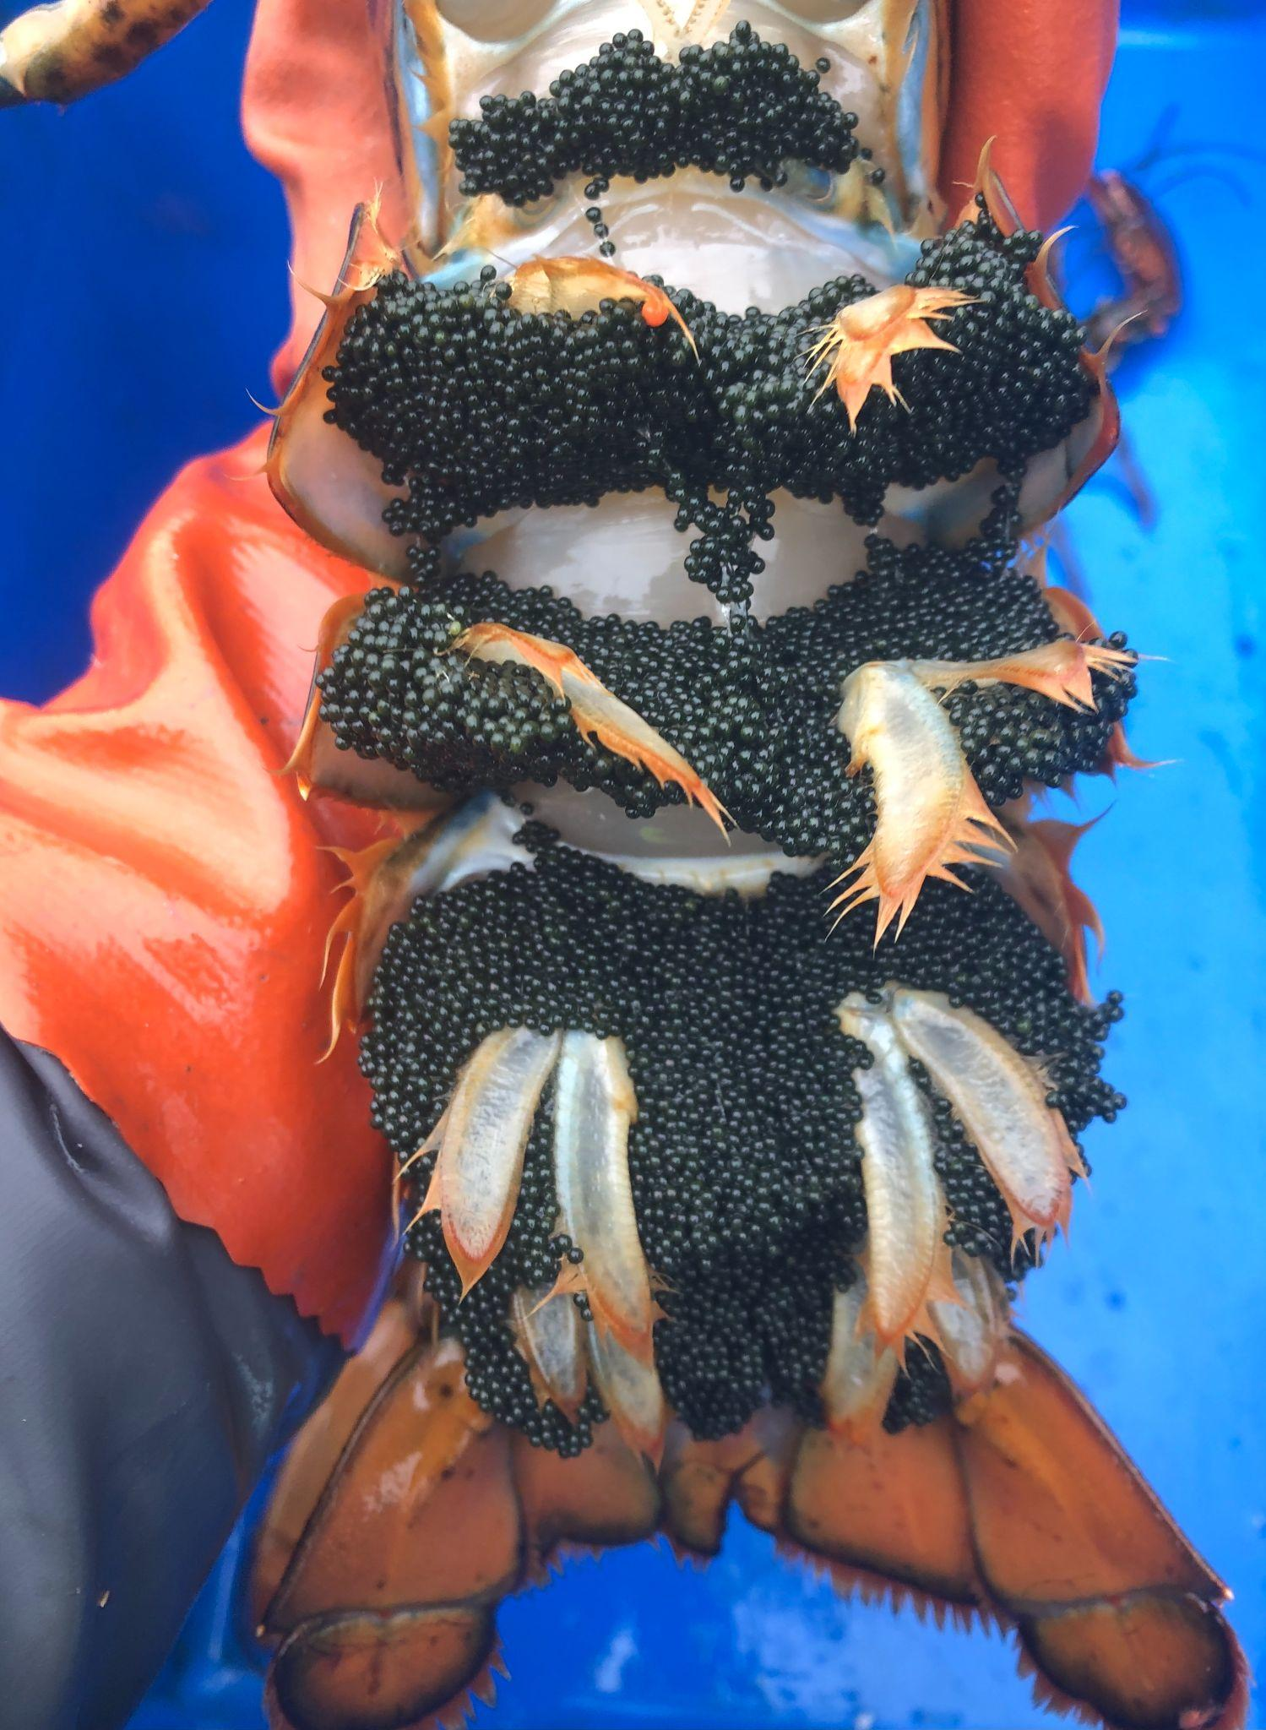
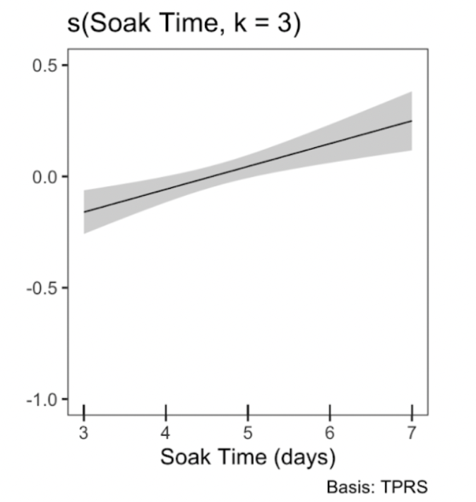
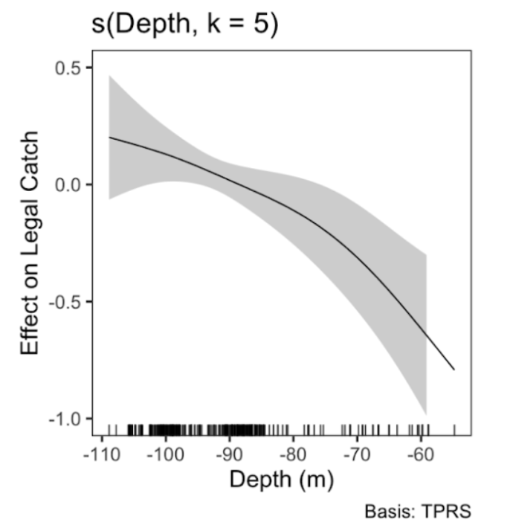
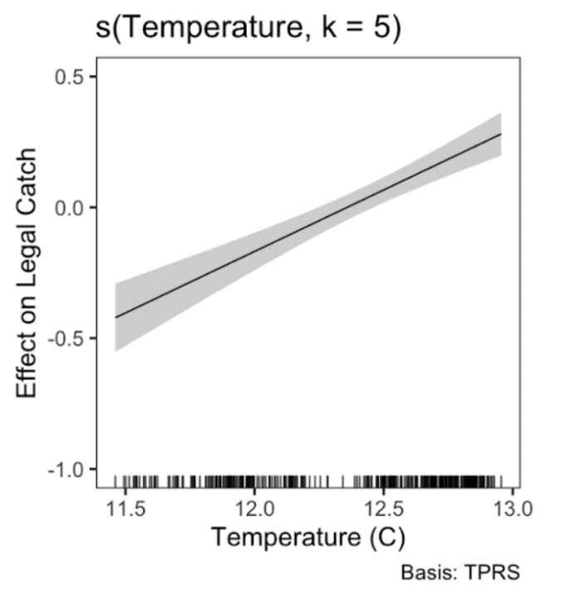


Incorporating Environmental Variability in BACI Modeling of American Lobster Catch Dynamics
Everett Rzeszowski
Maine’s Center for Sustainable
Coastal Resources

Slide 2
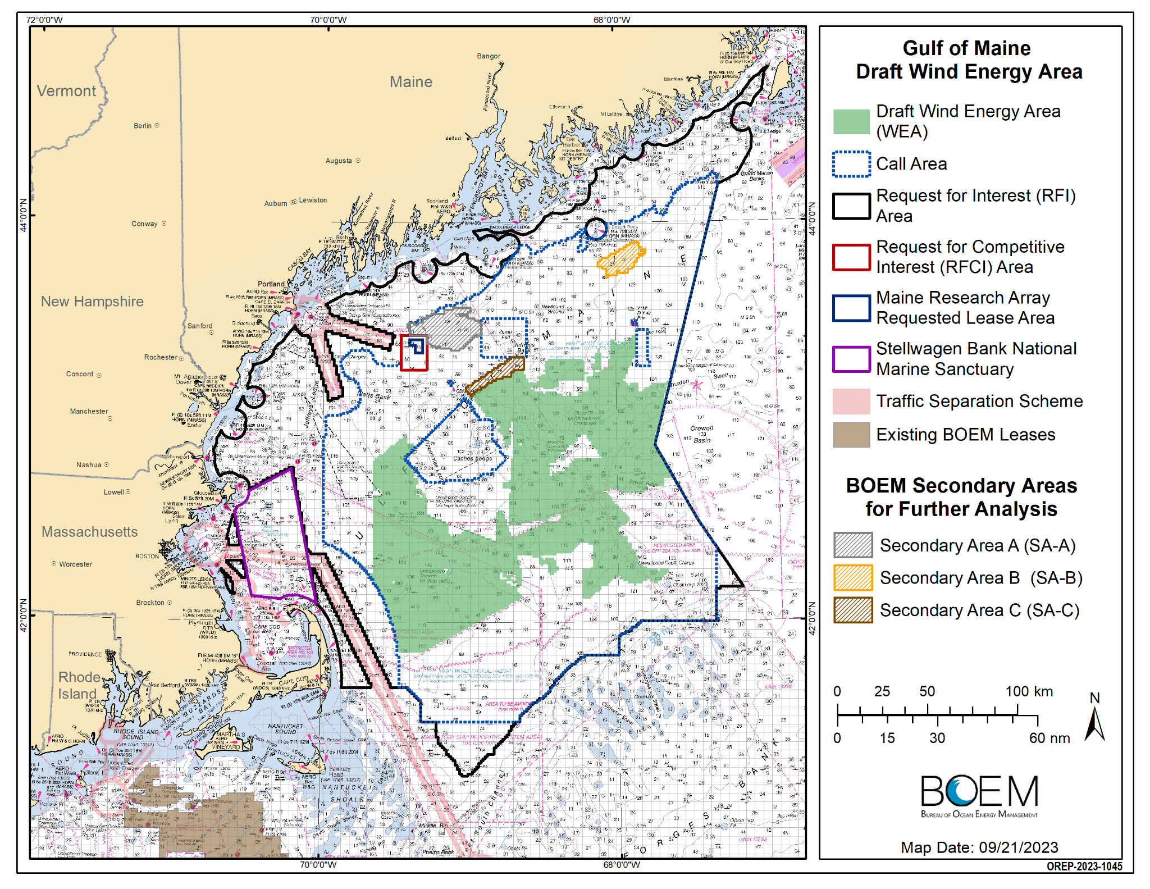
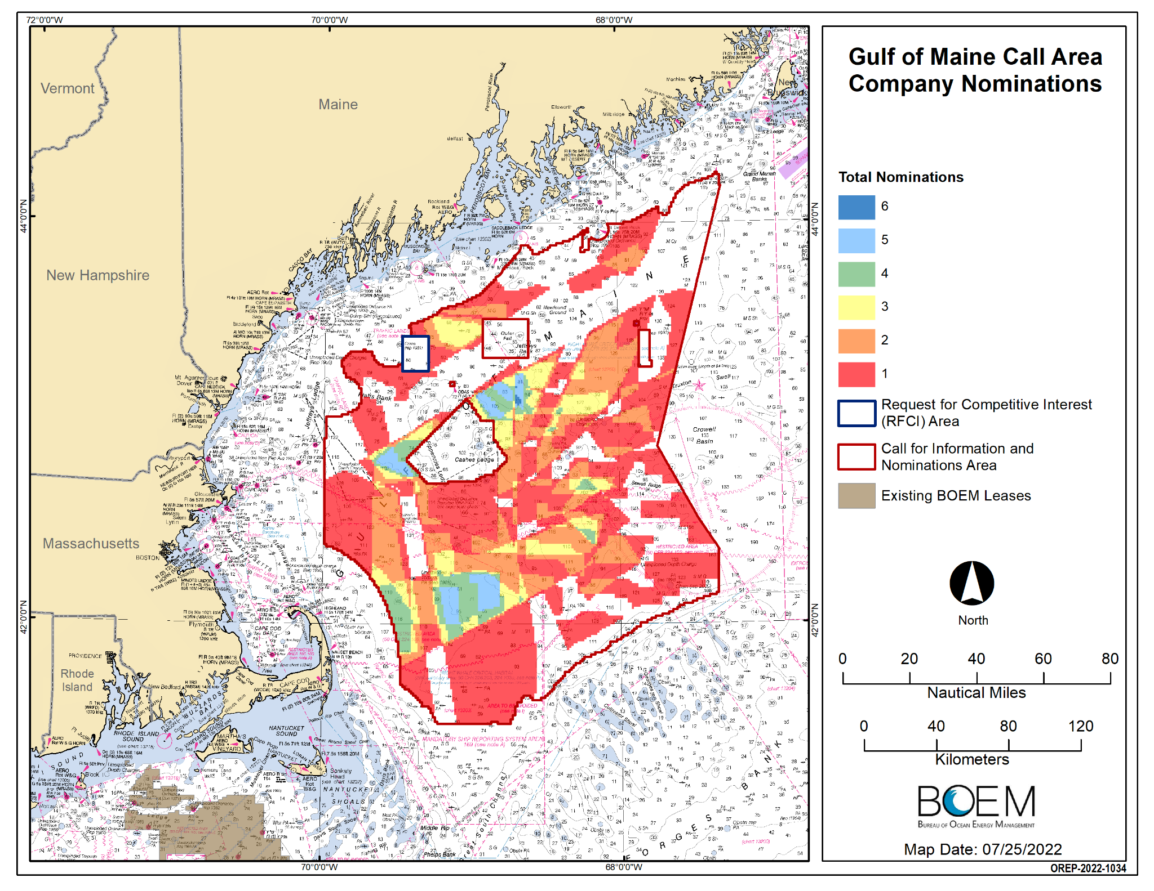
Gulf of Maine Wind Development
US East Coast has 20+ projects in the development pipeline.
Environmental impacts may accumulate locally or across the larger region.
It is important to resolve the potential economic impact of biological changes.
Gulf of Maine Call Area Company Interest

Slide 3
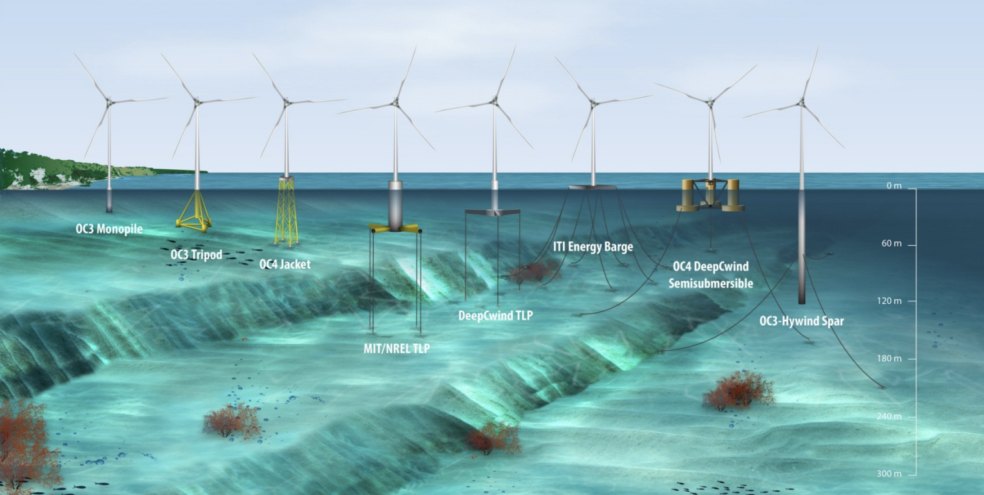
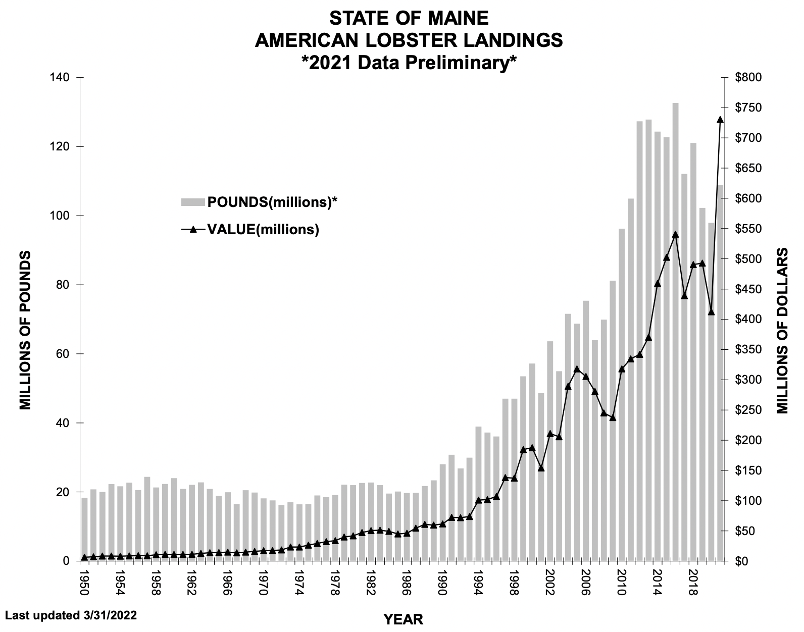
Gulf of Maine Wind Dev.
Gulf of Maine depth will require floating wind infrastructure.
Gulf of Maine lobster abundance has increased >500% since 1970s.
The resource supports the most valuable single-species fishery in the country.
Top: Offshore Wind Infrastructure Options;
Bottom: Time series of Maine lobster fishery landings (grey) and value (black).

Slide 4
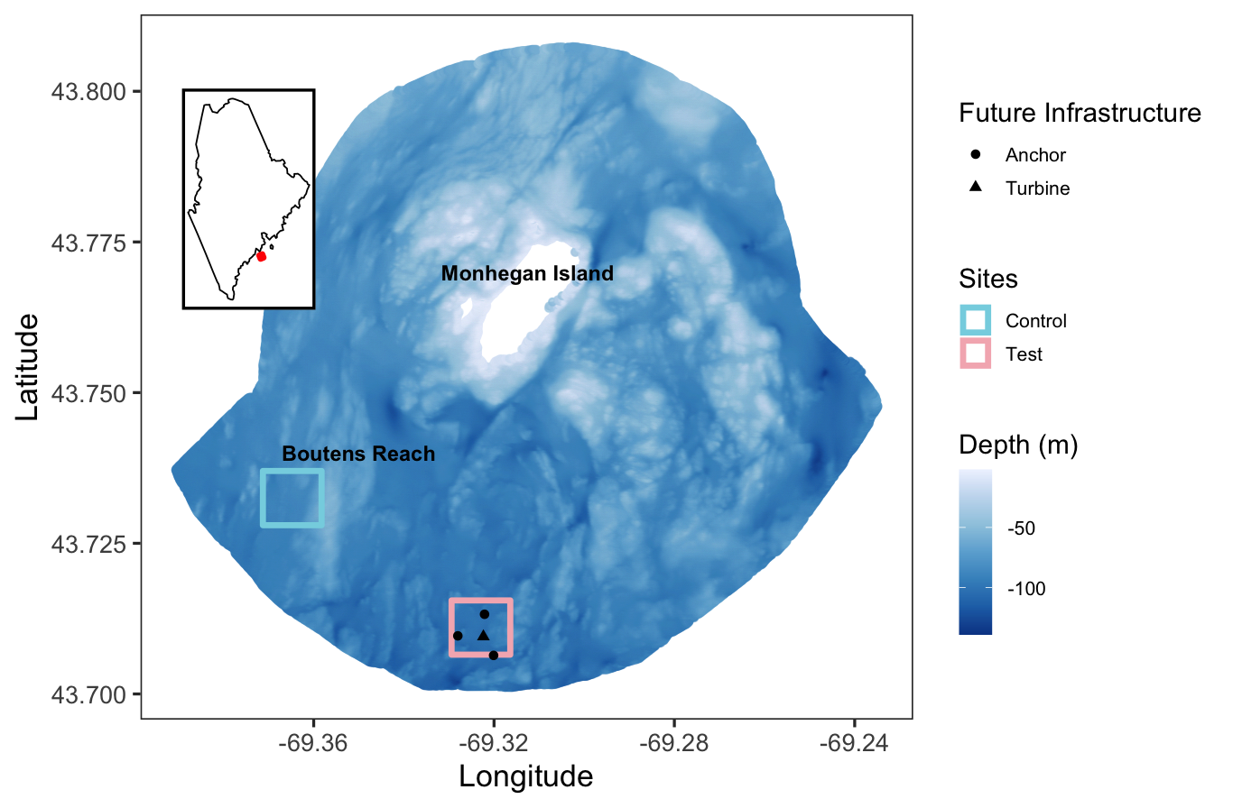
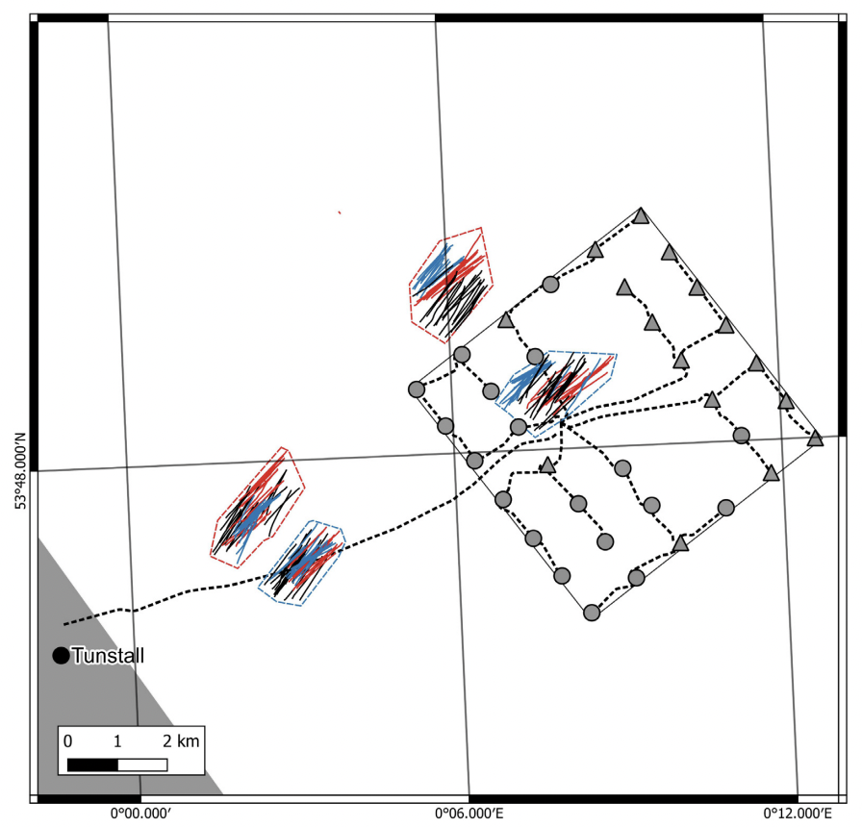
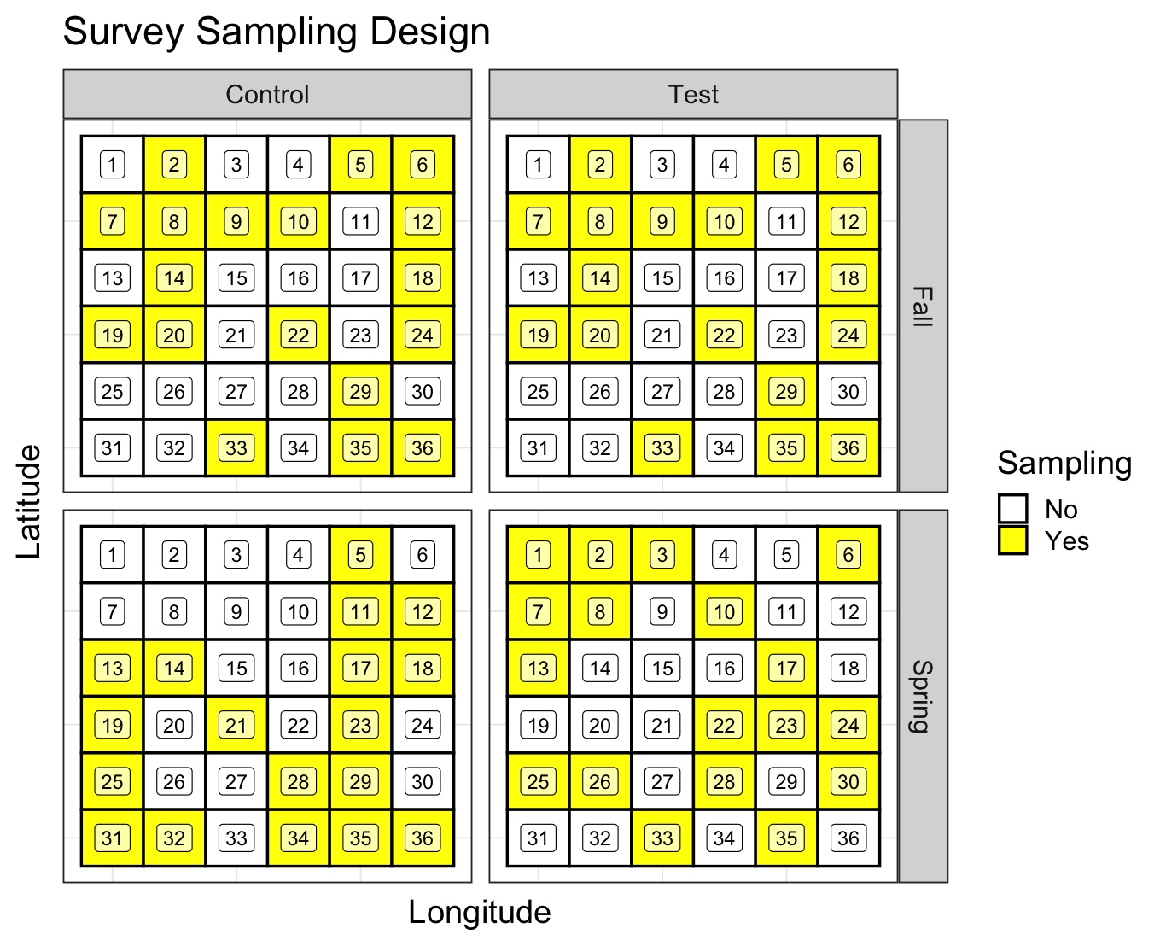
BACI survey methods
Survey design from Roach et al. (UK):
Survey design from Rzeszowski et al. (Gulf of Maine):

Slide 5
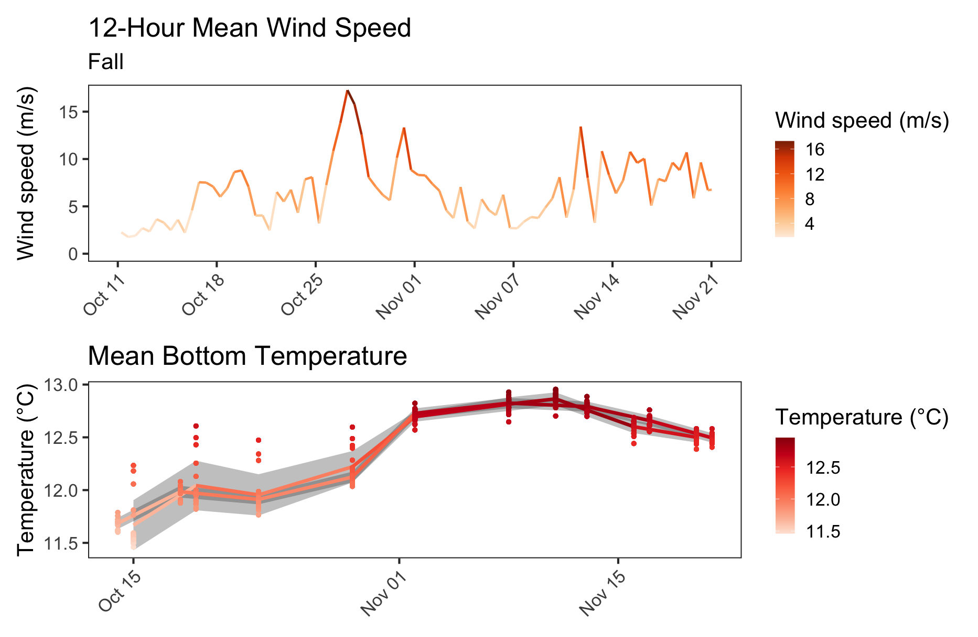
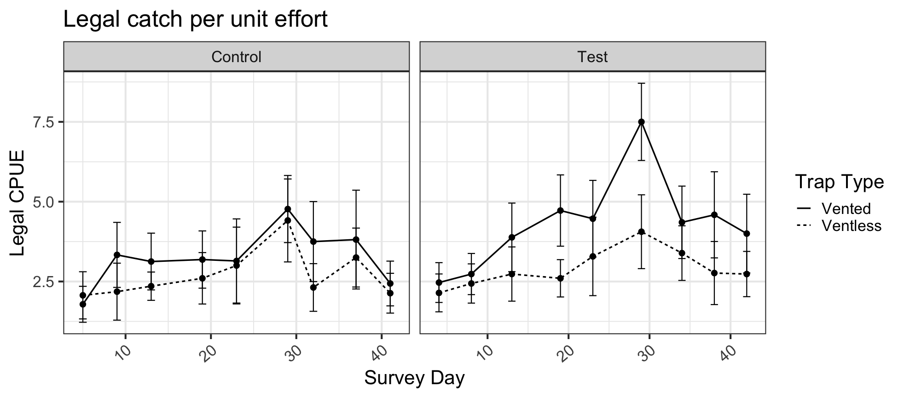
Catch, wind and temperature
In Fall surveys changes in lobster catch was correlated with higher bottom temperatures.
Bottom temperature rose at both sites following Fall overturn / storm events.
Fall Survey wind, temperature and legal catch time series’.

Slide 6
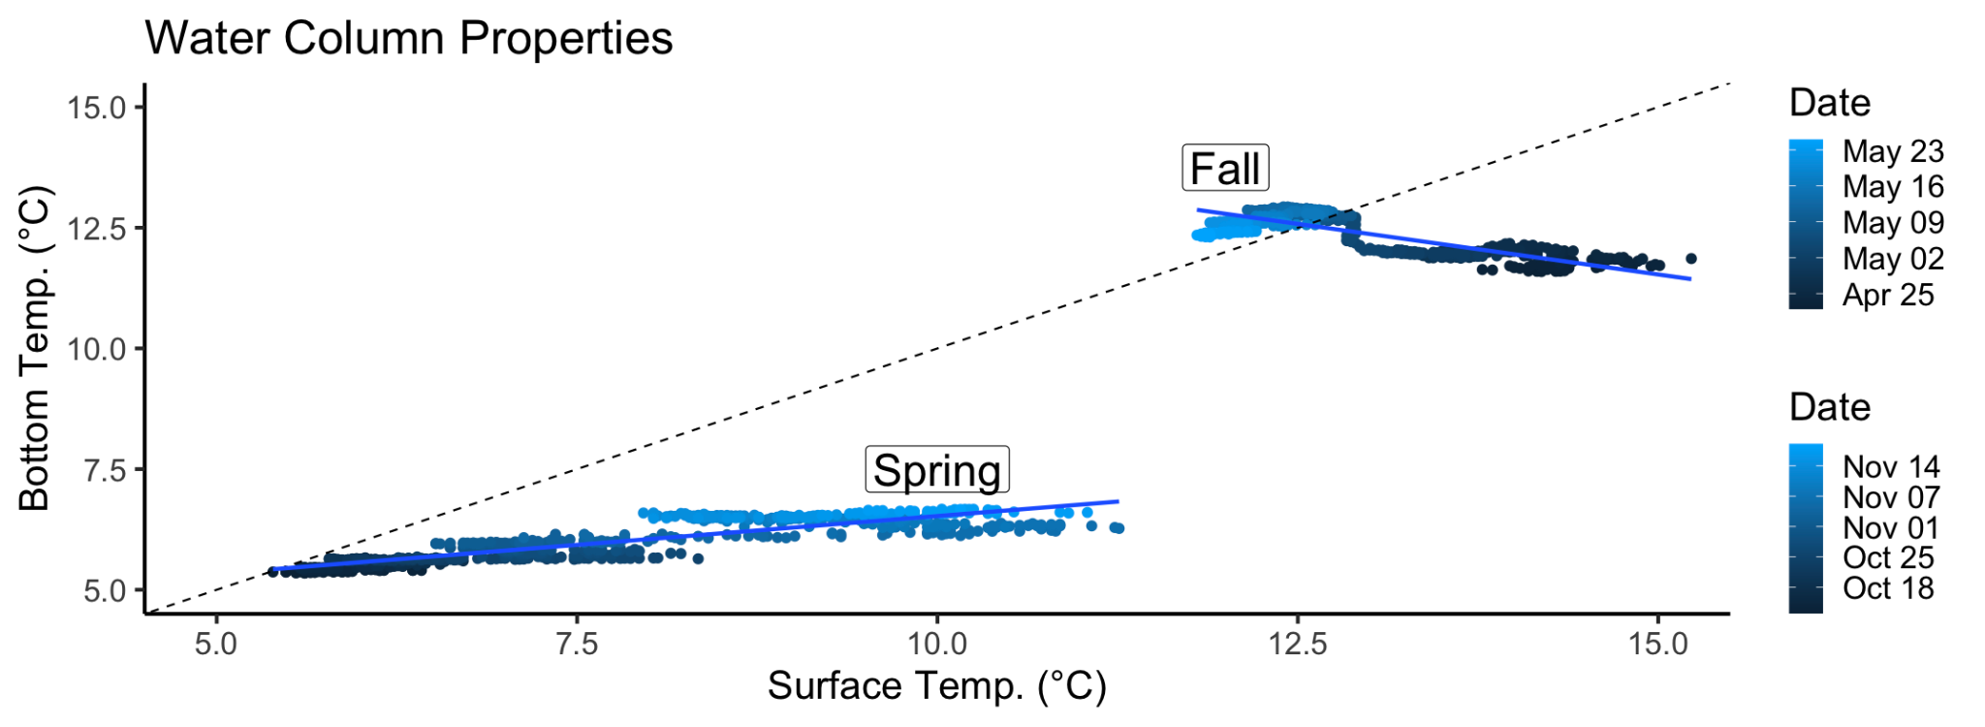
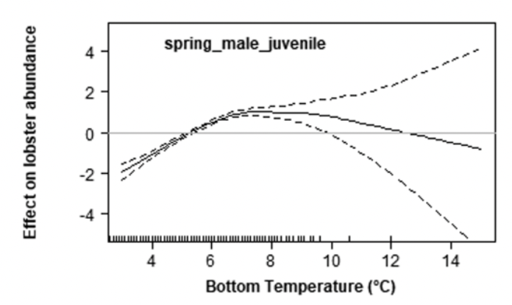
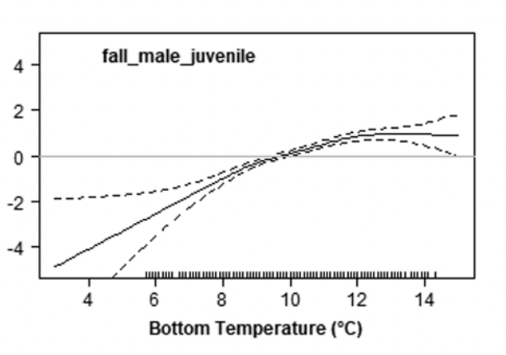
Seasonal and Life History Temperature Preferences
Lobsters acclimate to local temperature during each season.
This allows for differences in seasonal temperature response.
Difference in water column stratification and temperature between Fall and Spring surveys.
Seasonal temperature preferences effect on abundance from Tanaka et al. 2019.

Slide 7
GAM Temperature Response
Season and Size-class specific models account for differential responses to variation in conditions.
Models can then account for variation in catch attributable to environmental change over the course of an offshore wind project.
Effect of Temperature on Legal Catch in Fall Model

Slide 8
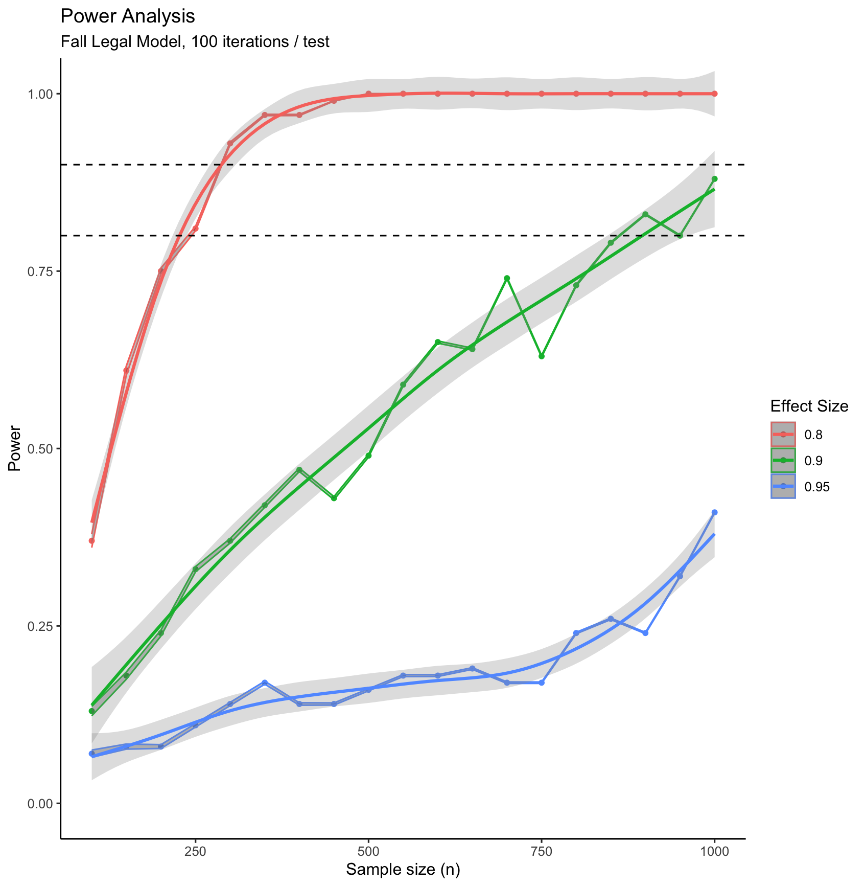
Power analysis
Approximate fishery samples over the same survey period
To effectively deploy the survey a power analysis must be conducted.
If baseline data is not available for power analysis oversampling the first survey year is suggested.
Fig. Power analysis results
Power analysis results.

Slide 9
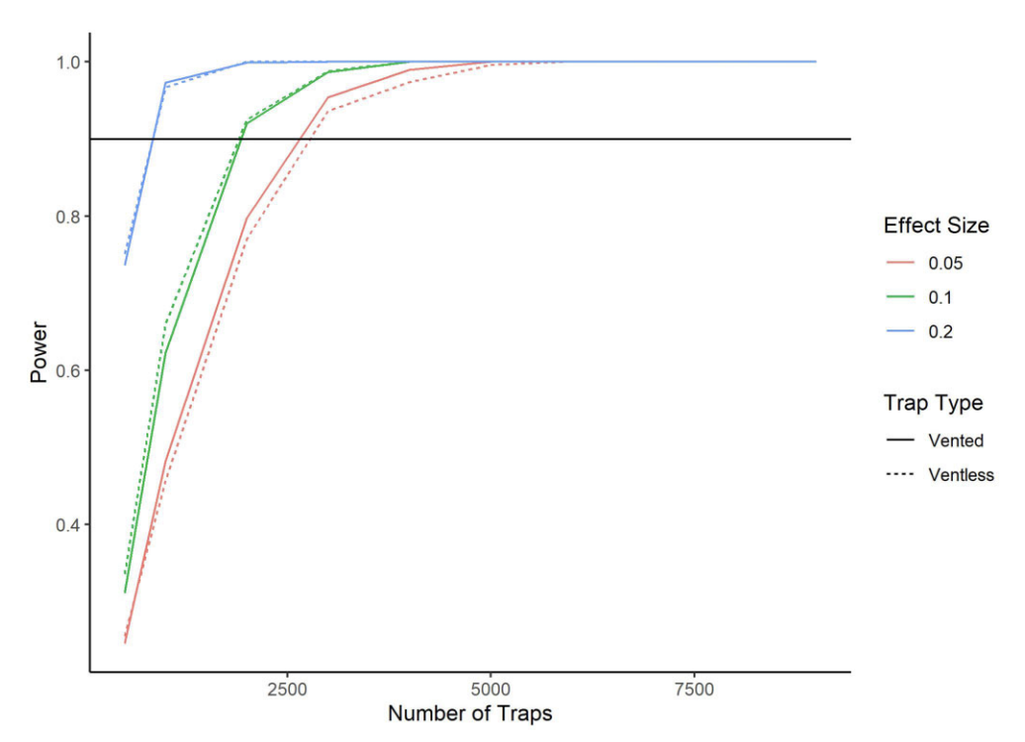
BACI vs. BAG sensitivity
The BAG is more spatially structured than BACI with non-random sampling on a distance gradient.
Study goals may inform the level of sample stratification appropriate for answering a question.
Power analysis results from Livermore et al. (2023) BAG simulation.

Slide 10
Take home points
Baseline Monhegan wind site surveys indicate that Fall catch dynamics are economically important for the local fishery and tightly linked to Fall overturn.
Non-linear models can disentangle environmental from additional effects on catch variation.
BAG surveys structure spatial heterogeneity while BACI must consider analytical methods to include these sources of variability.

Slide 11

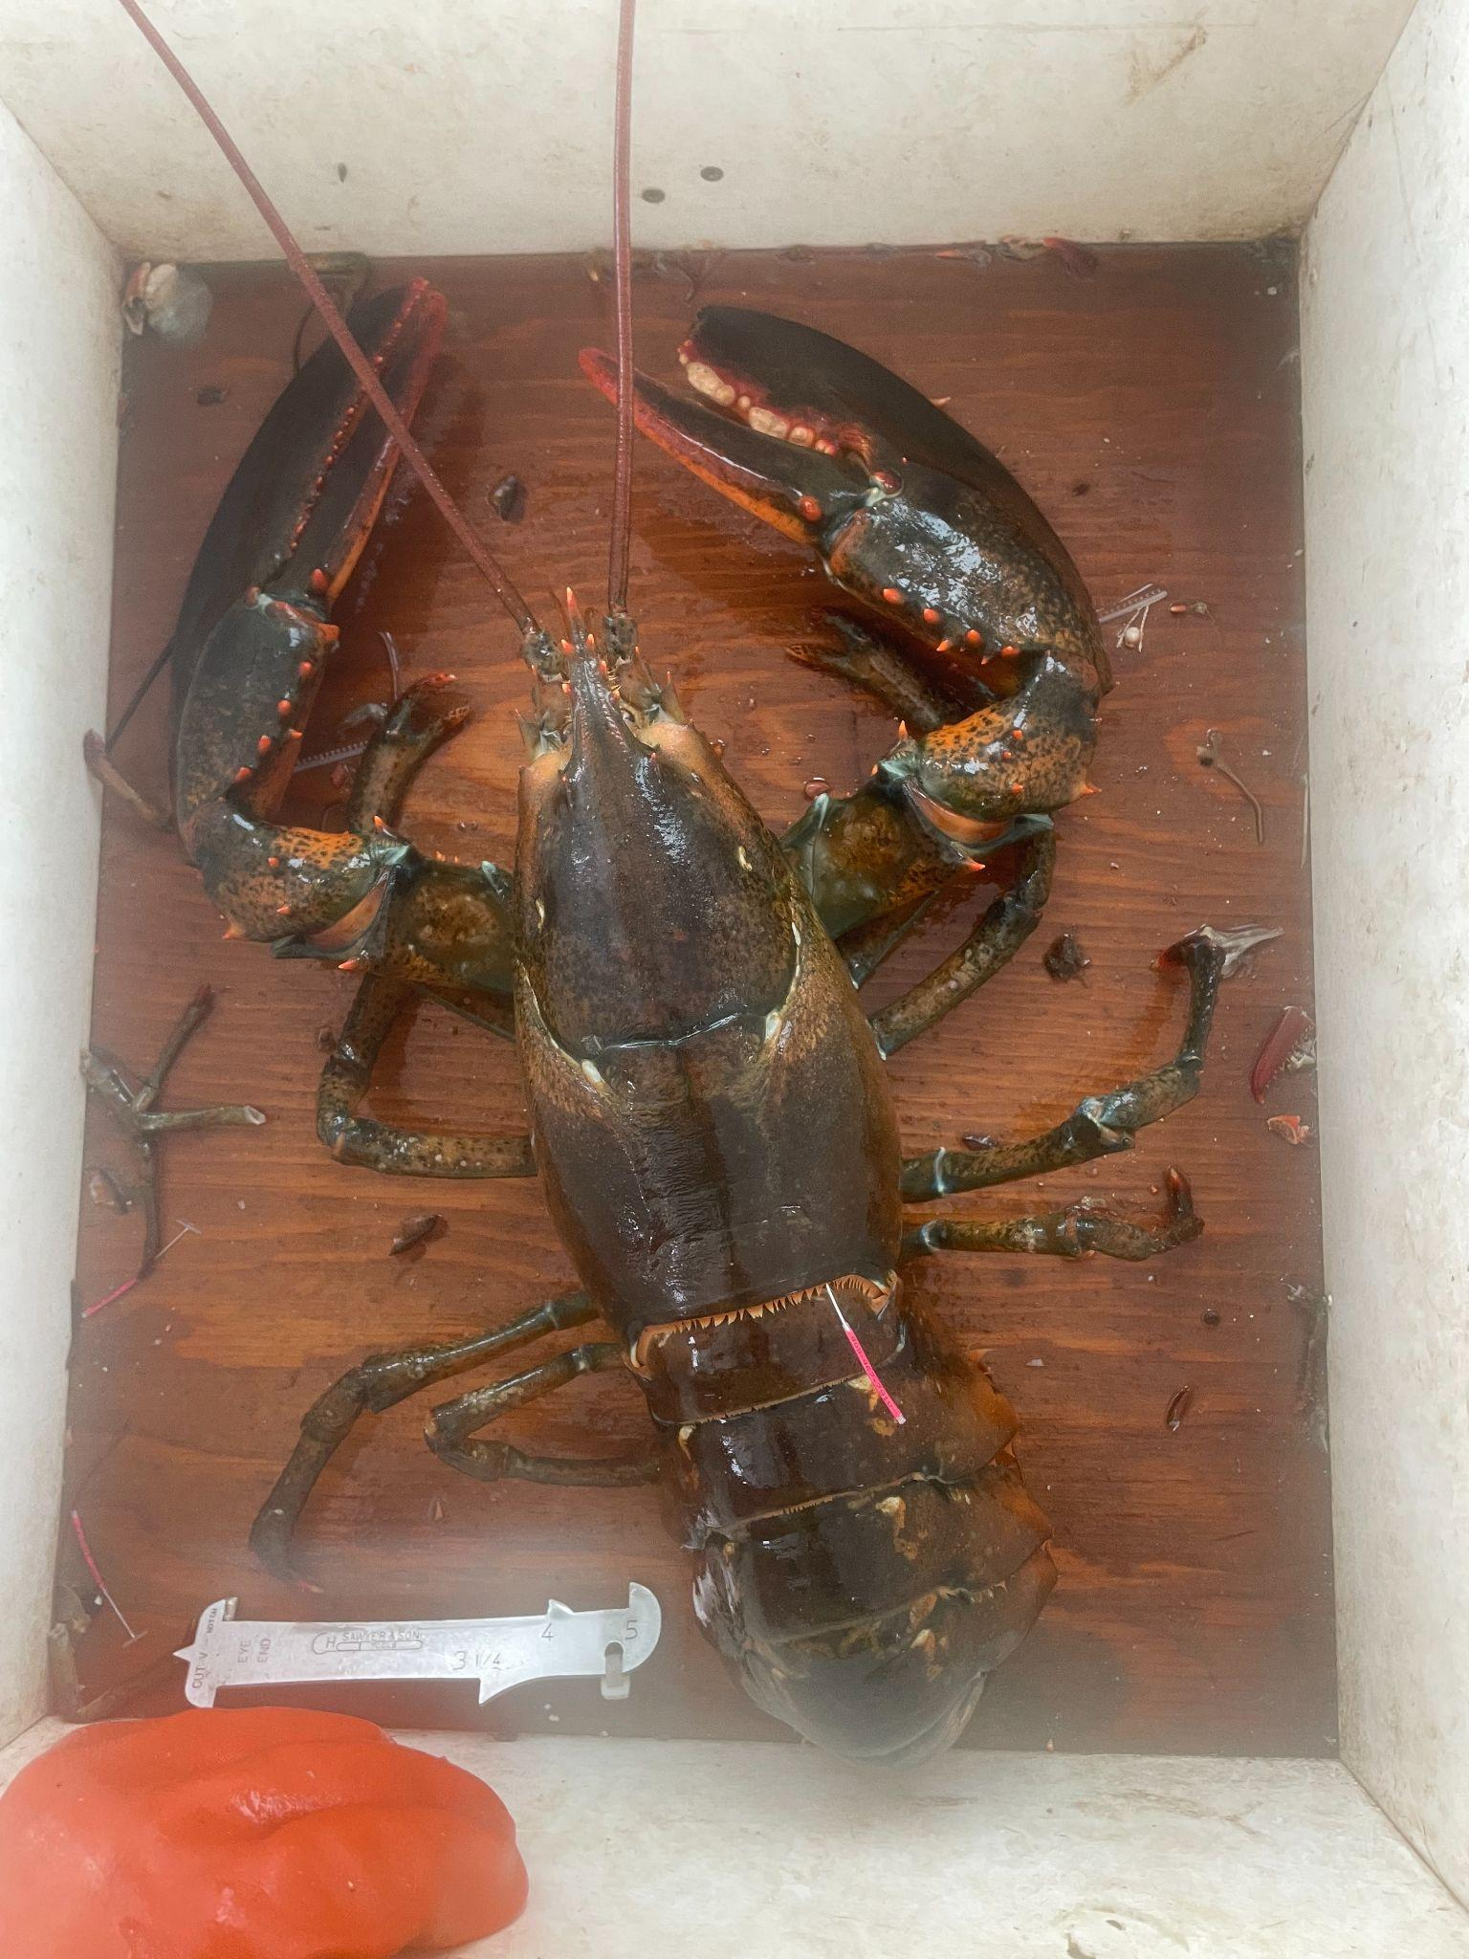

Acknowledgements
Questions?
Thank you
Chris Smith, F/V Alice B
Lucas Cioffi, F/V Mule
Brandon Bezio, F/V Chum Again
Nick Cennamo, F/V Chris
Chris Cash, Lobster Institute
Kathleen Reardon, ME DMR
Andrew Goode, UMaine
Damian C. Brady, UMaine
MyResearchGate:

